Slide 1
A Complex History: Native American Boarding Schools and Football
Dr. Stephanie M. Lemley

Slide 2
Text Sets
Draper, et al. (2010) defines text as “ any representational resource or object that people intentionally imbue with meaning, in the way they either create or attend to the object, to attend to a particular purpose.” (p. 28).

Slide 3
Text Sets—Where to Start?
Mentor text—the mentor text is the text that you build the rest of your text set around. It can be:
children’s informational picture book,
chapter book
Children’s fiction picture book
Poem
Really it could be any text that you want!
Once you’ve found your mentor text, you start building your text set with supplemental texts.
Supplemental texts reinforce and build upon the mentor text content.
Good ideas for supplementals:
Videos
Images
Audio files
Political cartoons
Charts/tables/graphs
Maps

Slide 4
Native American Boarding Schools
MCCRS-SS
US History: 1877 to Present
Evaluate the Dawes Act for its effect on tribal identity, land ownership, and assimilation of American Indians.

Slide 5
What do you know about Native American Boarding Schools?

Slide 6
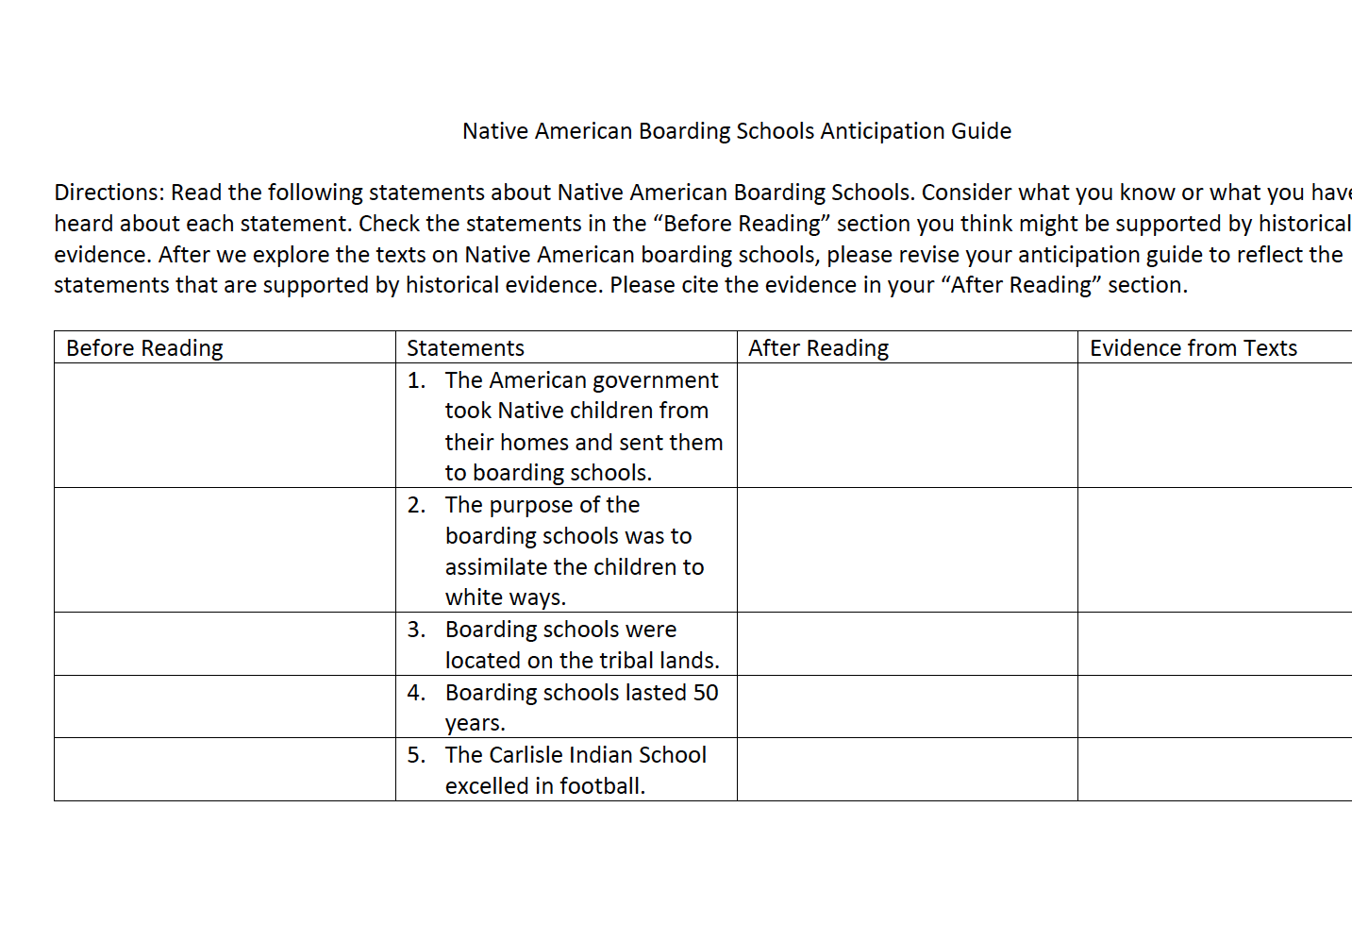
Anticipation Guide-Native American Boarding Schools

Slide 7
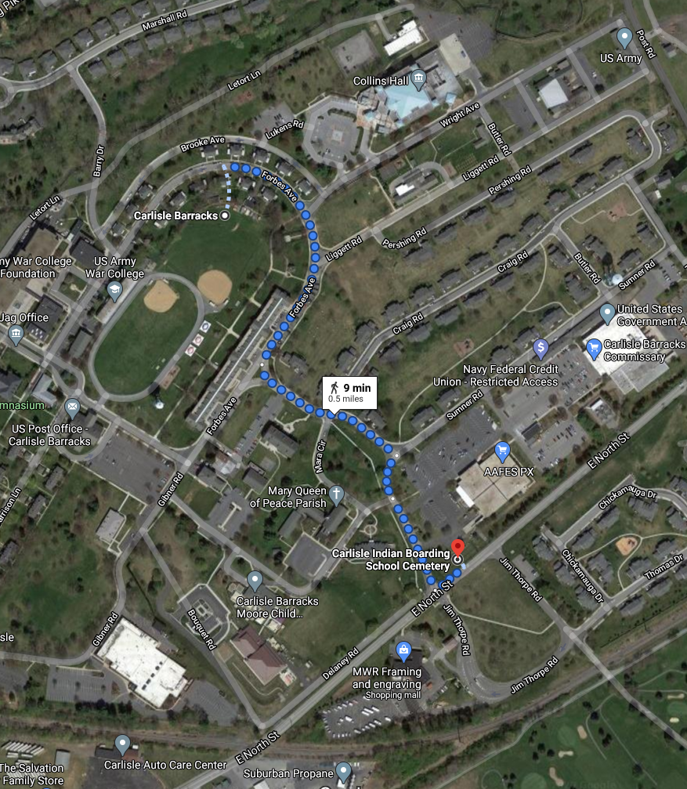
Area of PA

Slide 8
“Kill the Indian, Save the Man.”
Civil War veteran Lt. Col. Richard Henry Pratt
Opened in 1879 in Pennsylvania, the Carlisle Indian Industrial School was the first government-run boarding school for Native Americans. Civil War veteran Lt. Col. Richard Henry Pratt spearheaded the effort to create an off-reservation boarding school with the goal of forced assimilation. The Army transferred Carlisle Barracks, a military post not in regular use, to the Bureau of Indian Affairs for use as a boarding school.
Students were forced to cut their hair, change their names, stop speaking their Native languages, convert to Christianity, and endure harsh discipline including corporal punishment and solitary confinement. This approach was ultimately used by hundreds of other Native American boarding schools, some operated by the government and many more operated by churches.

Slide 9
Native American Boarding Schools
Native American boarding schools, also known as Indian Residential Schools, were established in the United States during the late 19th and mid 20th centuries with a primary objective of assimilating Native American children and youth into Euro-American culture, while at the same time providing a basic education in Euro-American subject matters. These boarding schools were first established by Christian missionaries of various denominations, who often started schools on reservations, especially in the lightly populated areas of the West. The government paid religious orders to provide basic education to Native American children on reservations in the late 19th and early 20th centuries, with the last residential schools closing as late as 1973. The Bureau of Indian Affairs (BIA) founded additional boarding schools based on the assimilation model of the off-reservation Carlisle Indian Industrial School.

Slide 10
Native American Boarding Schools
The boarding school concept can be traced to Civil War Army Lieutenant Richard Henry Pratt, who led a unit of Buffalo Soldiers near Oklahoma. Together they captured 72 men, and transported them to Fort Marion, Florida. Upon arrival, the captives were forced to cut their hair, dress in military uniforms, and learn English. In essence, they were being groomed to resemble their white captors in an effort to “civilize” them. During a time in U.S. history when the policy toward Native Americans was usually one of forced removal and even extermination, the idea of assimilation, was considered progressive.
After his experience assimilating the prisoners at Ft. Marion, Pratt came up with the idea of immersing Native American children in white culture through boarding schools. He convinced several tribal leaders on reservations and in Ft. Marion to send their children with him, arguing that if they were to learn English they could read and understand the treaties signed between governments. In 1879, the first class of 147 children, many of them children of tribal chiefs, traveled to Pennsylvania to the newly created Carlisle Indian Industrial School.

Slide 11
About Carlisle
The complex history of Carlisle is both tragic and uplifting. While Pratt and his supporters believed they were helping the students, the boarding school experience stripped them of their customs, culture, and heritage. Disease and harsh conditions took their toll, and hundreds of children died. Many were returned to their families, but 186 children are still buried on the site today.
But along with that trauma and tragedy, Carlisle gave students an opportunity to explore the world outside of the reservations they called home. The school fielded many highly regarded athletic teams, including baseball and football teams with sports icon Jim Thorpe. The internationally acclaimed Carlisle band performed at the inauguration of President Theodore Roosevelt and every other inauguration held during its 39 years of operation. From the ranks of Carlisle alumni rose many noted activists and advocates who championed the cause of cultural preservation.

Slide 12
About Carlisle
As time went on, more local schools opened across the United States to educate Native Americans, which meant fewer students needed to travel east to Pennsylvania to attend Carlisle. A Congressional investigation surrounding the management of the school in 1914 resulted in declining attendance and morale. When World War I began in 1917, enrollment further declined.
On September 1, 1918, the school was officially closed, and the buildings were transferred back to the U.S. Army to serve as a rehabilitation hospital for soldiers wounded in the war. Today, the site is home to the U.S. Army War College.

Slide 13
980L
When superstar athlete Jim Thorpe and football legend Pop Warner met in 1904 at the Carlisle Indian Industrial School in Pennsylvania, they forged one of the winningest teams in American football history. Called “the team that invented football,” they took on the best opponents of their day, defeating much more privileged schools such as Harvard and the Army in a series of breathtakingly close calls, genius plays, and bone-crushing hard work.
But this is not just an underdog story. It’s an unflinching look at the persecution of Native Americans and its intersection with the beginning of one of the most beloved—and exploitative—pastimes in America, expertly told by nonfiction powerhouse Steve Sheinkin.

Slide 14
Character Quotes

Slide 15
Additional sources
The Library of Congress Primary Source Set on Native American Boarding Schools: https://www.loc.gov/classroom-materials/native-american-boarding-schools/
Carlisle Indian School Project: https://carlisleindianschoolproject.com/
America’s Story from American’s Library: http://www.americaslibrary.gov/jb/gilded/jb_gilded_thorpe_1_e.html
Carlisle Indian School Digital Resource Center: http://carlisleindian.dickinson.edu/
PBS Utah: https://www.pbsutah.org/whatson/pbs-utah-productions/unspoken-americas-native-american-boarding-schools

Slide 16
Students relaxing on The Lawn at Carlisle Picture taken between 1901 and 1903

Slide 17
Before and After

Slide 18
See-Think-Wonder Strategy with Images
What do you see in the pictures?
When were these pictures taken?
Why are these pictures significant

Slide 19
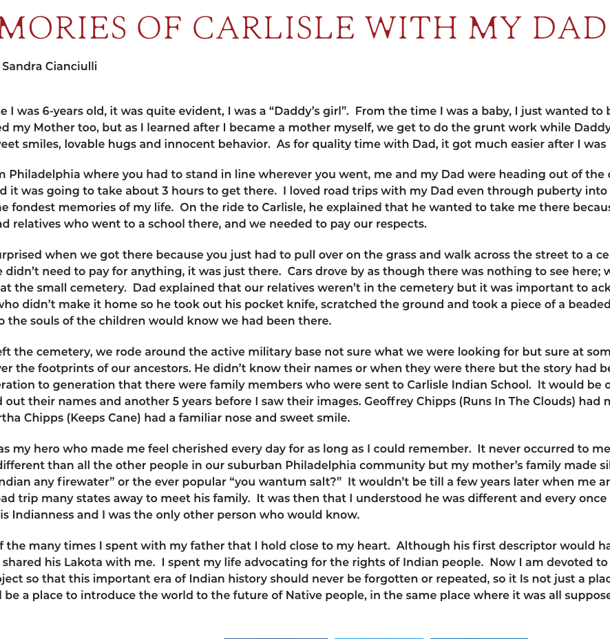
Carlisle Indian School Project
https://carlisleindianschoolproject.com/memories-of-carlisle-with-my-dad/

Slide 20
Additional Sources
http://carlisleindian.dickinson.edu/cemetery-information

Slide 21
Carlisle Football Team

Slide 22
Jim Thorpe
Taken between 1910 and 1920

Slide 23
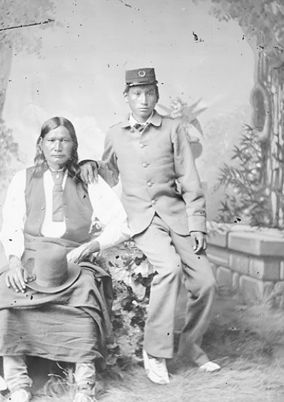
Studio portrait of Left Hand and his son, U.S. Grant (Grant Left Hand). Grant is wearing a school uniform.

Slide 24
Color-Symbol-Image Strategy
Look at the primary source and using the C-S-I strategy, fill in the chart. Remember to justify your choices with a well-developed explanation.
COLOR What color best represents this? | Symbol What symbol best represents this? | Image What image best represents this?
Why did you choose this color? | Why did you choose this symbol? | Why did you choose this image?

Slide 25
Jim Thorpe as a Student
http://carlisleindian.dickinson.edu/student_files/james-thorpe-student-file

Slide 26
In-Character Chat
Pair up with a partner and decide who “Partner 1” is and who “Partner 2” is.
Listen to the teacher read an excerpt from the text.
When she stops, the designated partner will speak as though he/she is the character in the text.
As your teacher begins to read again, stop talking and listen. Repeat with Partner 2.

Slide 27
Jim Thorpe: Athlete
https://www.youtube.com/watch?v=66XjZN55dtA

Slide 28
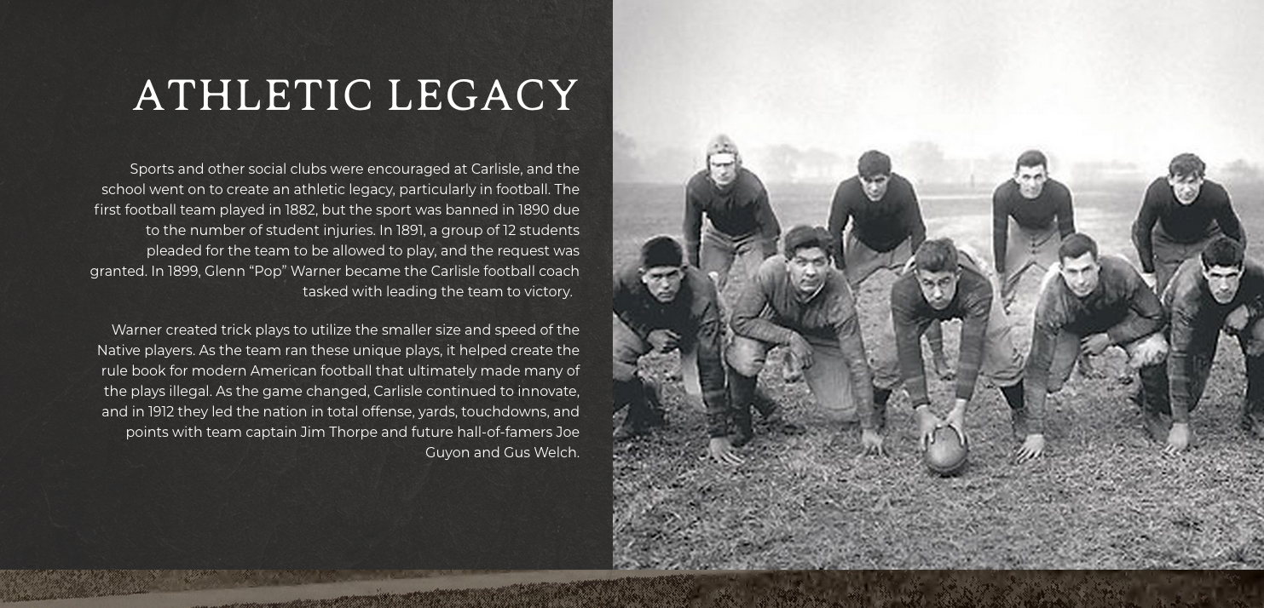
Carlisle Football Team

Slide 29
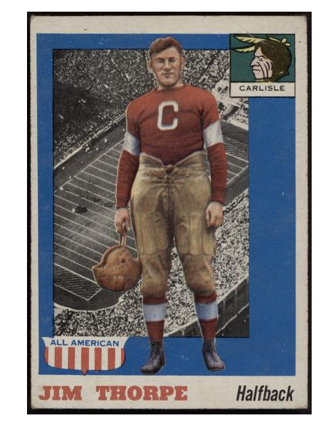
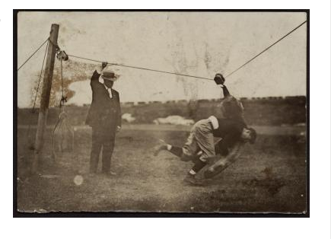

Slide 30
Ready Made Lesson Plan from the Library of Congress
https://www.loc.gov/classroom-materials/exploring-the-stories-behind-native-american-boarding-schools/

Slide 31
More Ready Made Sources
http://www.rcs.k12.in.us/tah/native-american-perspectives/between-two-worlds/teacher-resources
http://www.aicphub.com/lesson_plans/ml_boardingschools.html

