Slide 1
Taking Prisoners, not names: a sample of the Meso-American Empires.
Awesome civilizations that Columbus never saw, and what we know about them.

Slide 2
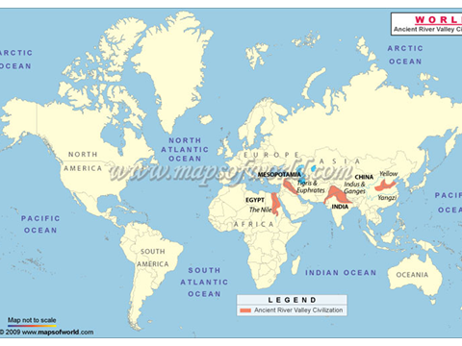

Slide 3
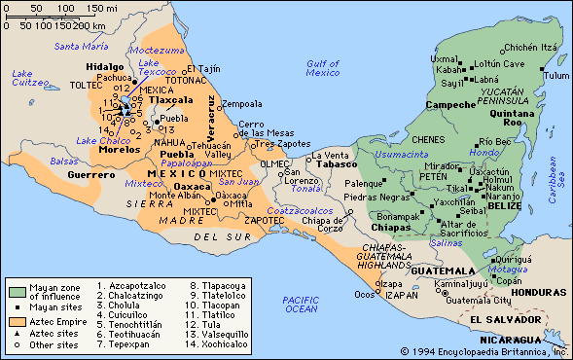
Mayan Civilization / Maya

Slide 4
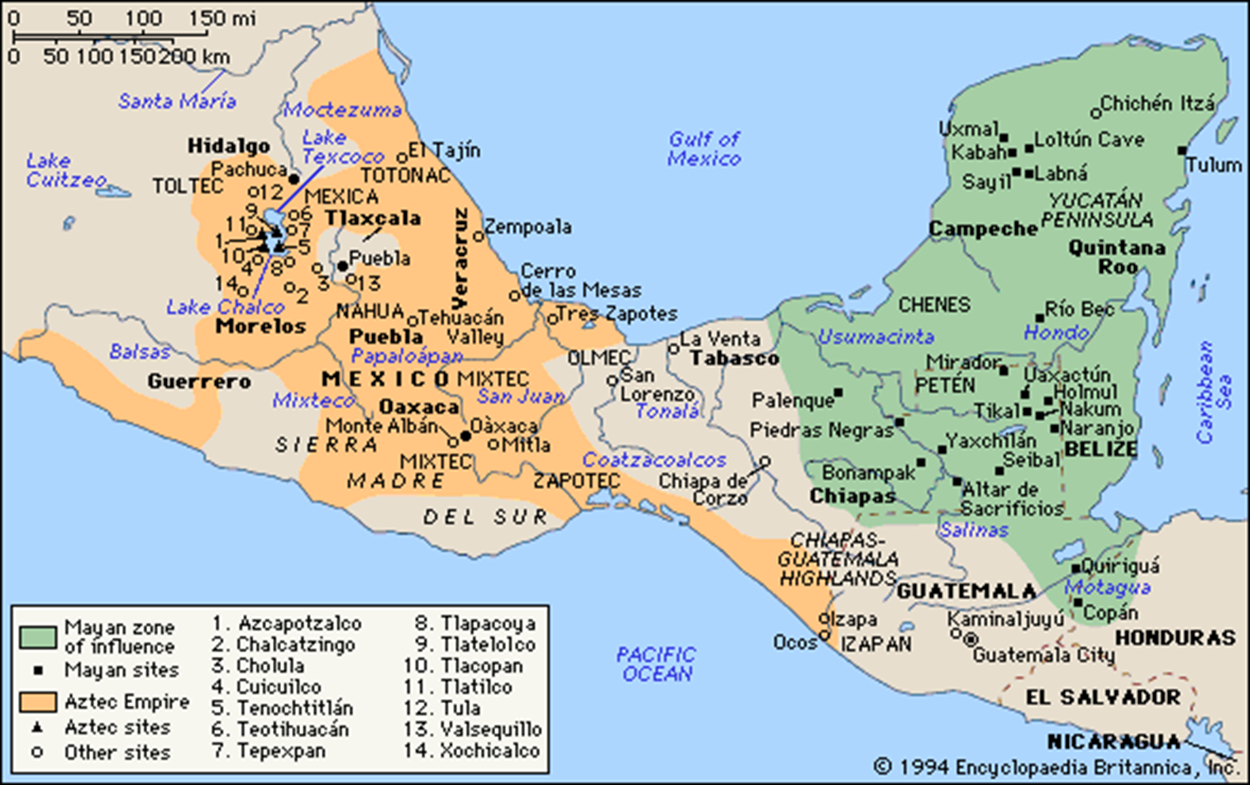
Mayan Civilization
Begins 2000B.C.E. ; height 250-900 C.E.
Complex systems of Math: 0, chart space, calendars
Complex systems of writing
By 600 C.E. totally engineered landscape
Water systems, agriculture, dense population 750 C.E.
Tikal
Constant war between city-states
909 C.E. last writing

Slide 5
Glyph
Sky
King
House
Child

Slide 6
Teotihuacán 150 B.C.E.

Slide 7
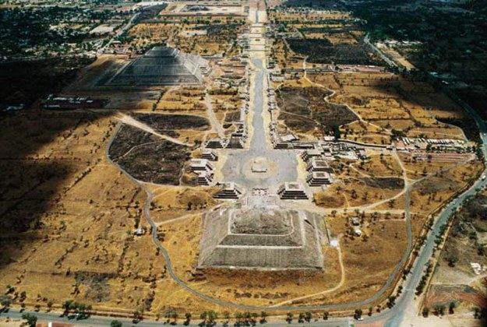

Slide 8
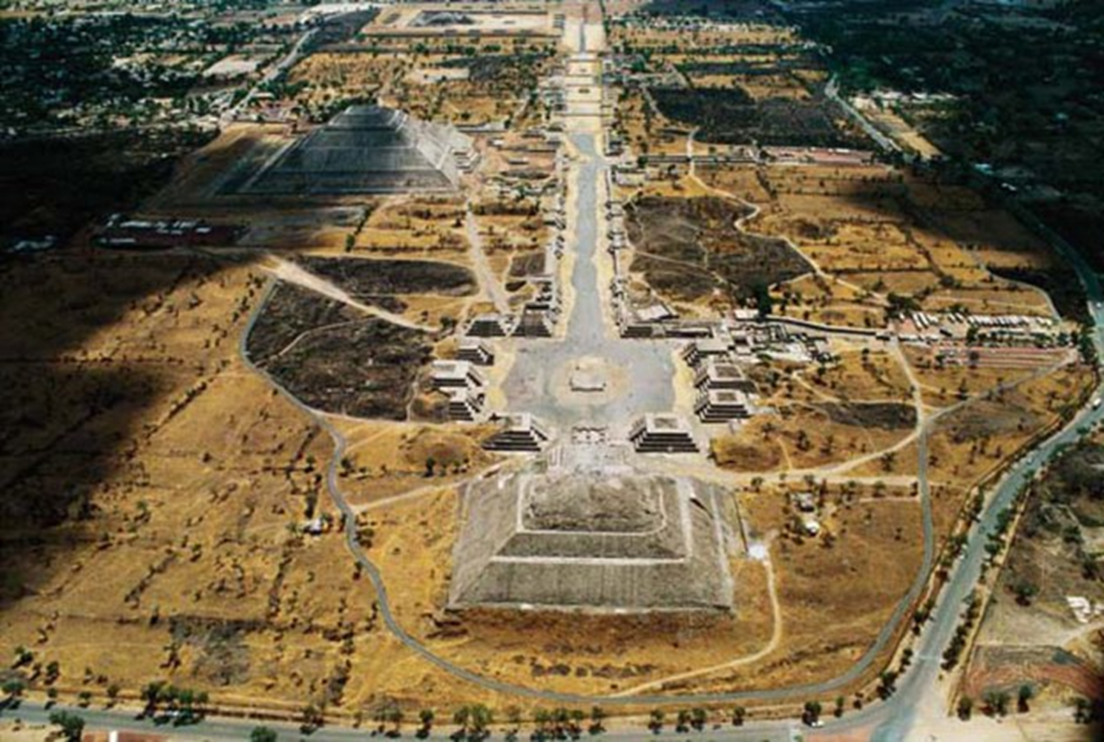
Teotihuacán 150 B.C.E.
150 B.C.E.-650 C.E.
Like “European” city
Markets, plazas, temples, palaces, apartment complexes, waterways, drainage systems
Major street “Street of the Dead”

Slide 9
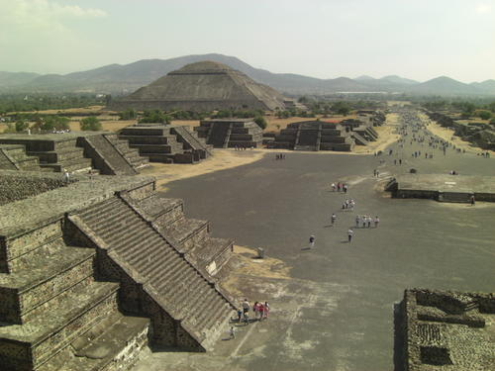
Teotihuacán 150 B.C.E.
150 B.C.E.-650 C.E.
Like “European” city
Markets, plazas, temples, palaces, apartment complexes, waterways, drainage systems
Major street “Street of the Dead”

Slide 10
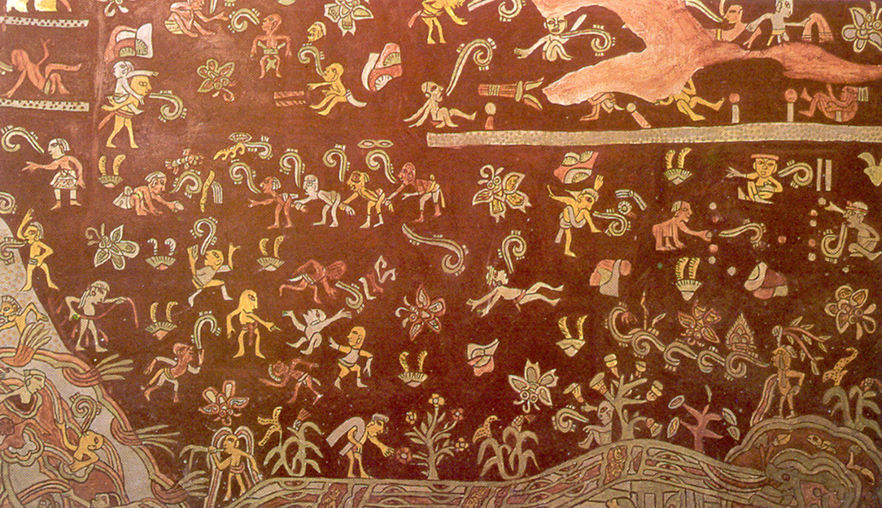
Teotihuacán 150 B.C.E.
150 B.C.E.-650 C.E.
Like “European” city
Markets, plazas, temples, palaces, apartment complexes, waterways, drainage systems
Major street “Street of the Dead”
Murals

Slide 12
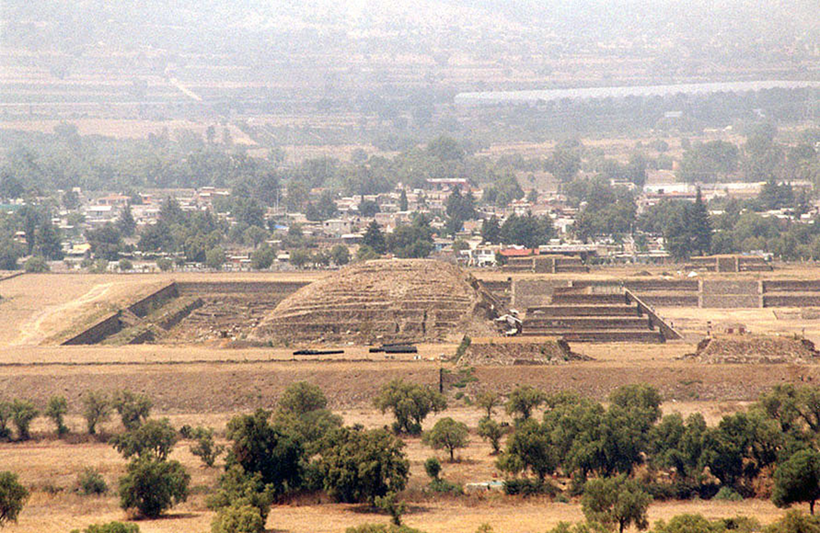
Teotihuacán 150 B.C.E.
150 B.C.E.-650 C.E.
Like “European” city
Markets, plazas, temples, palaces, apartment complexes, waterways, drainage systems
Major street “Street of the Dead”
Murals
Writing (can’t read)
Feathered Serpent

Slide 13
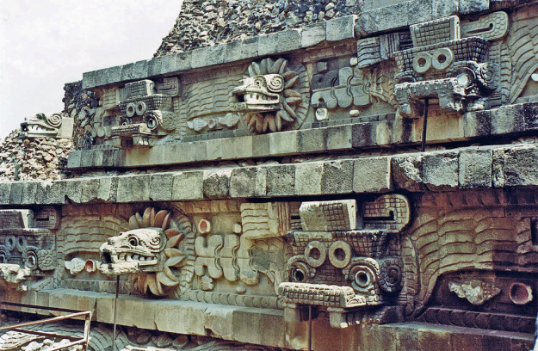

Slide 14
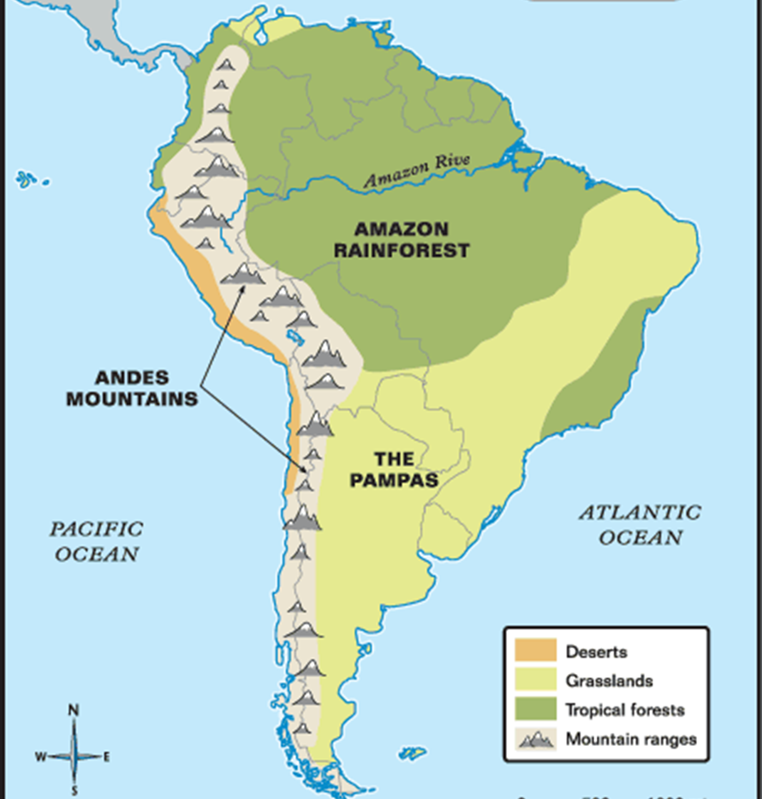
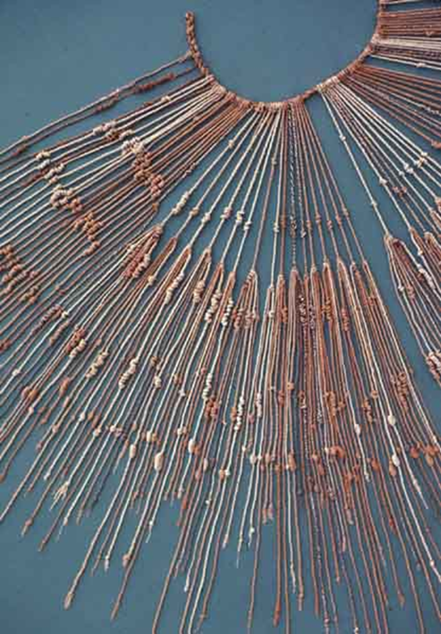
Andes Mountains Civilizations
Norte Chico
3000 B.C.E.
No city walls
Quipu
Moche Civilization
200 B.C.E. – 800 C.E.

Slide 15
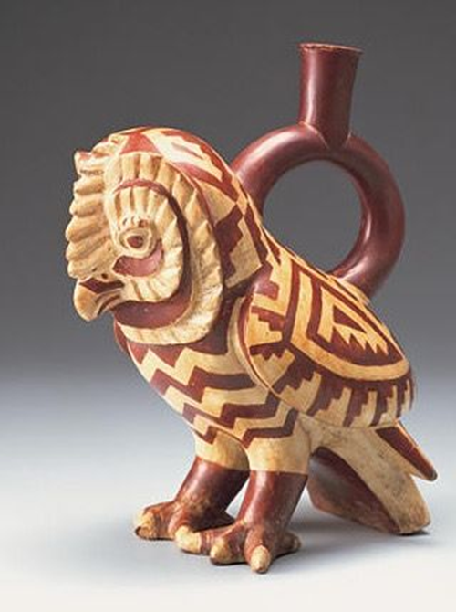
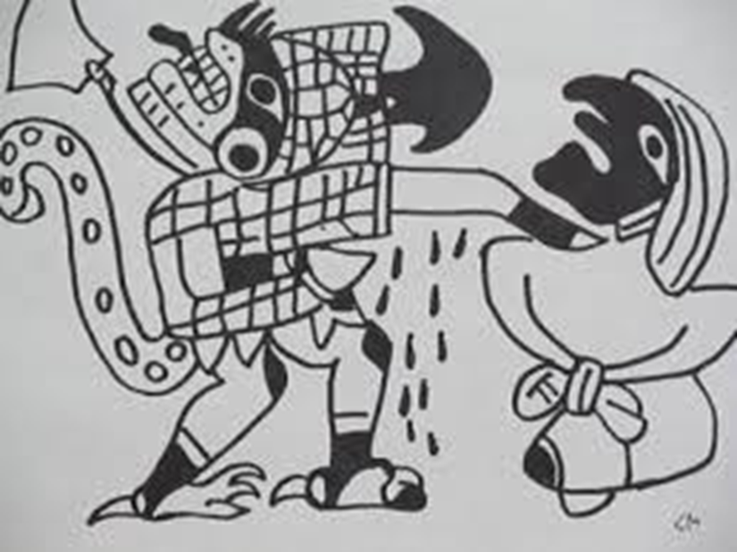
Andes Mountains Civilizations
Norte Chico
3000 B.C.E.
No city walls
Quipu
Moche Civilization
200 B.C.E. – 800 C.E.

Slide 16
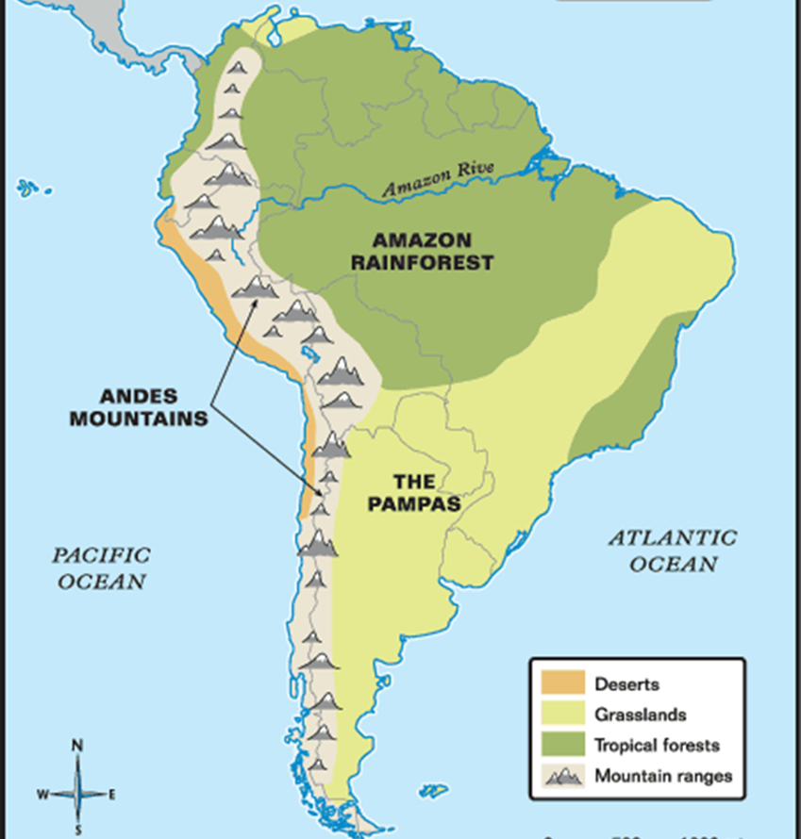
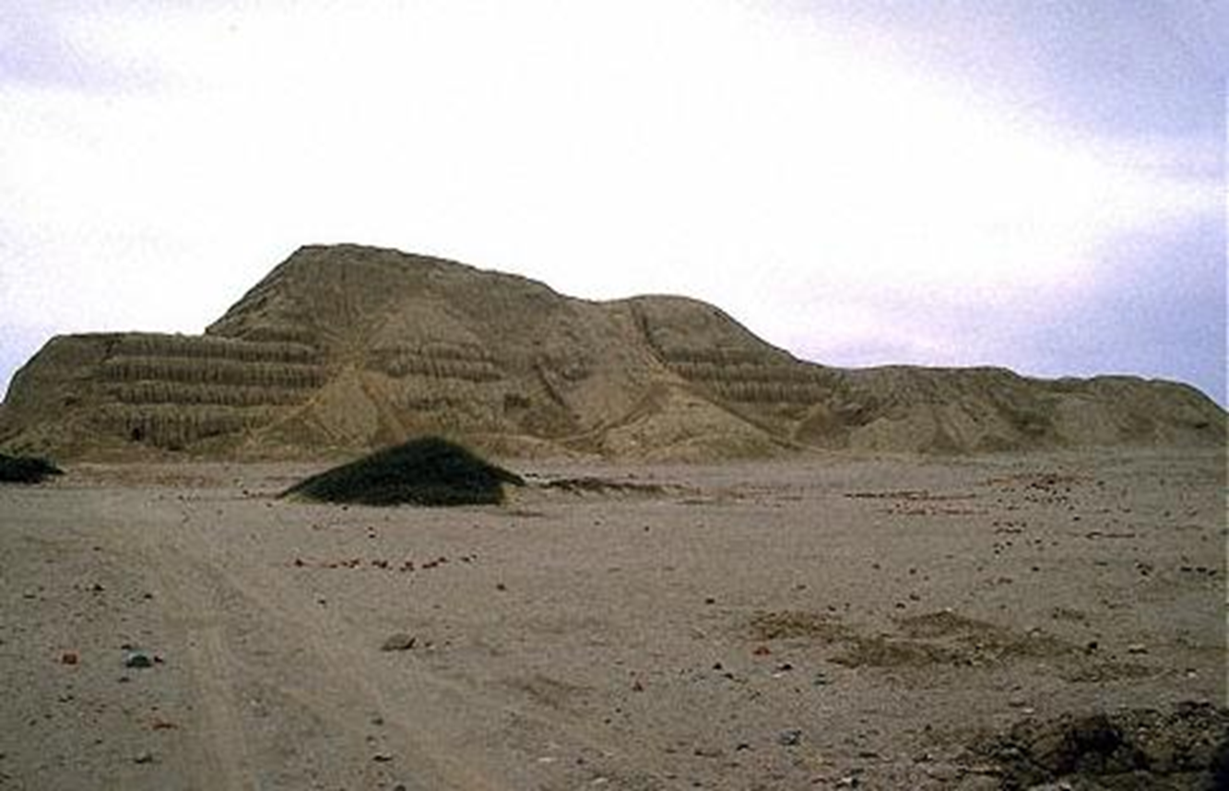
Andes Mountains Civilizations
Norte Chico
3000 B.C.E.
No city walls
Quipu
Moche Civilization
200 B.C.E. – 800 C.E.
Pyramid of the Sun
143 million bricks!

Slide 17
Andes Mountains Civilizations
Norte Chico
3000 B.C.E.
No city walls
Quipu
Moche Civilization
200 B.C.E. – 800 C.E.
Pyramid of the Sun
143 million bricks!
Lords of Sipán tomb

Slide 18
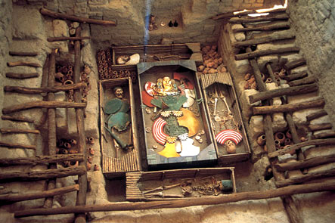
Lords of Sipán tomb

Slide 19
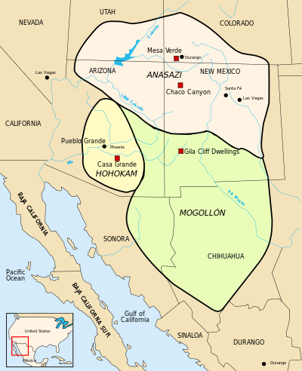
Ancestral Pueblo
1000 B.C.E. – 900 C.E.

Slide 20
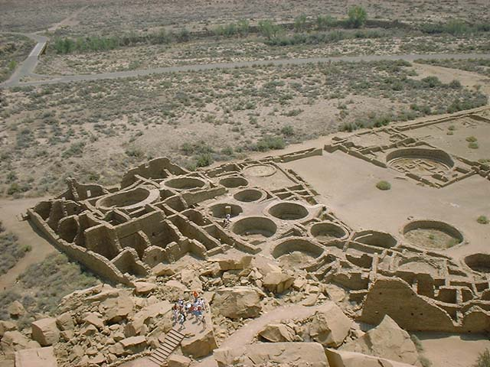
Chaco Canyon

Slide 21
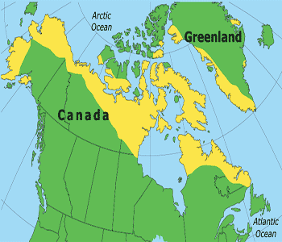
Inuit Groups
1000 B.C.E. --
1000 C.E. (and now)

