Slide 1
Gold, Frankincense, and Myrrh: Saudi Arabia and the Incense Trade
(“We Three Kings” is more than a Christmas Carol)
https://www.youtube.com/watch?v=BxDDojCkqzw

Slide 2
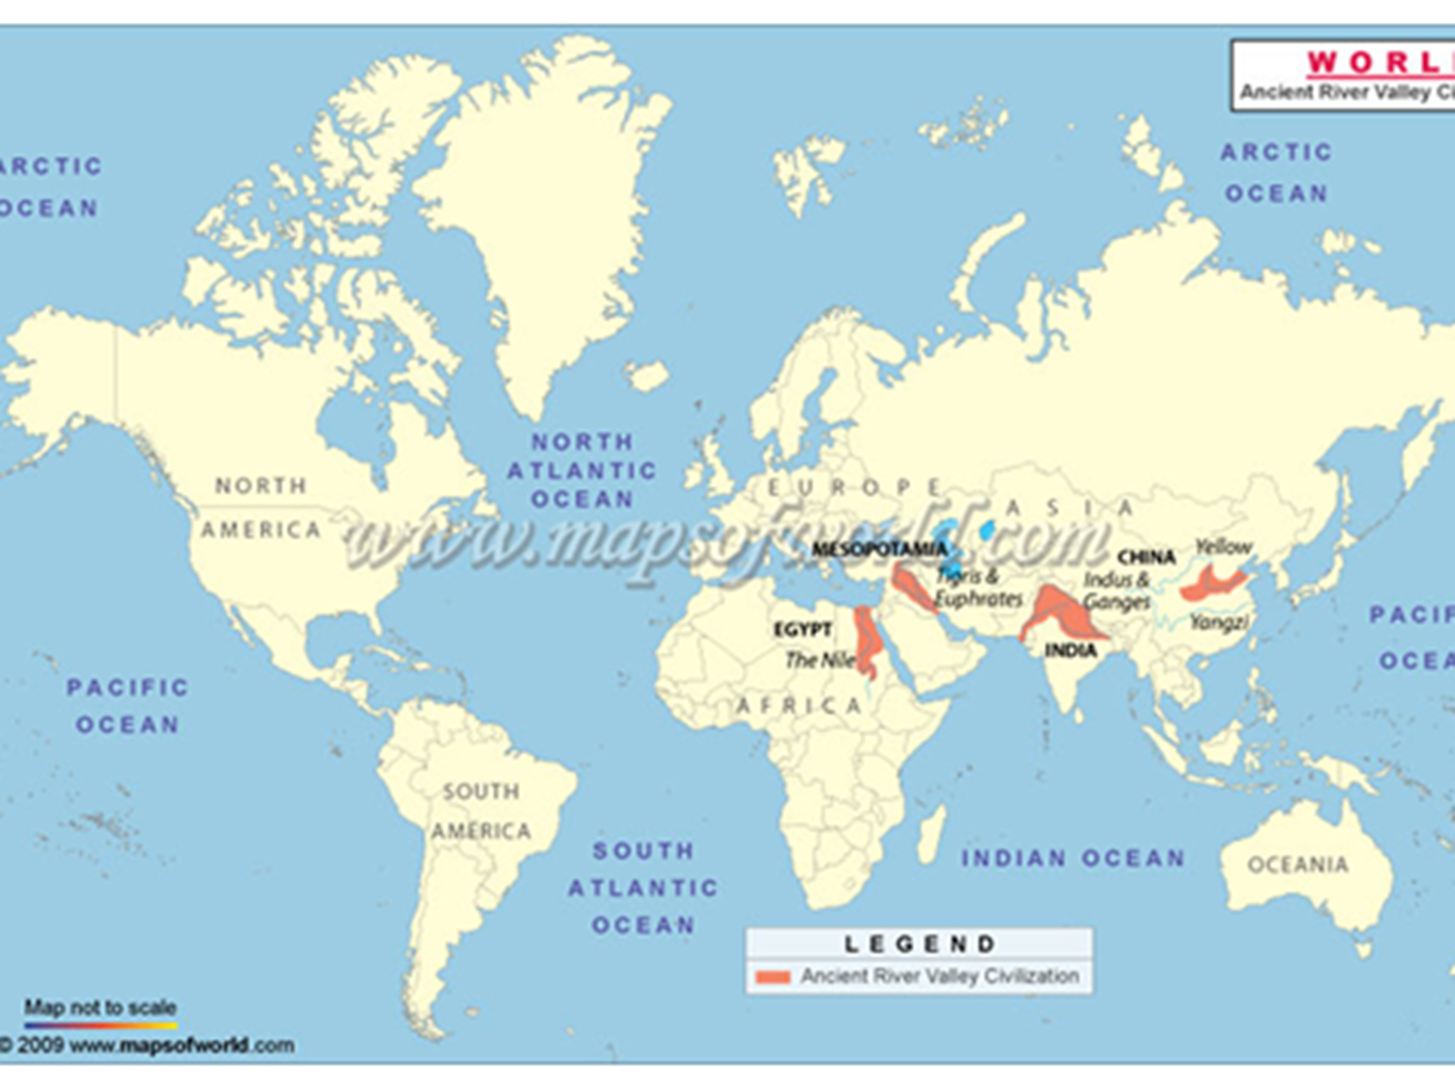

Slide 3
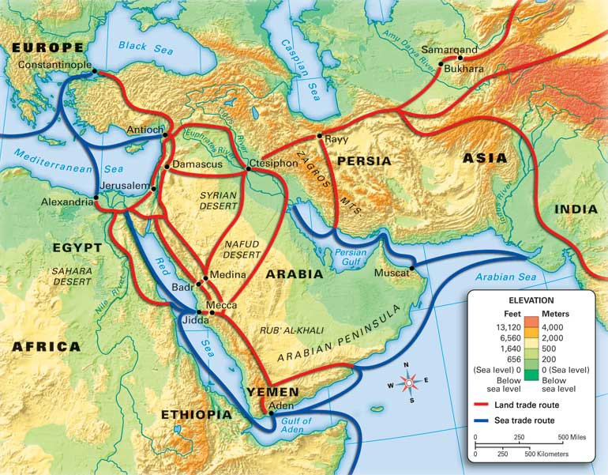

Slide 4
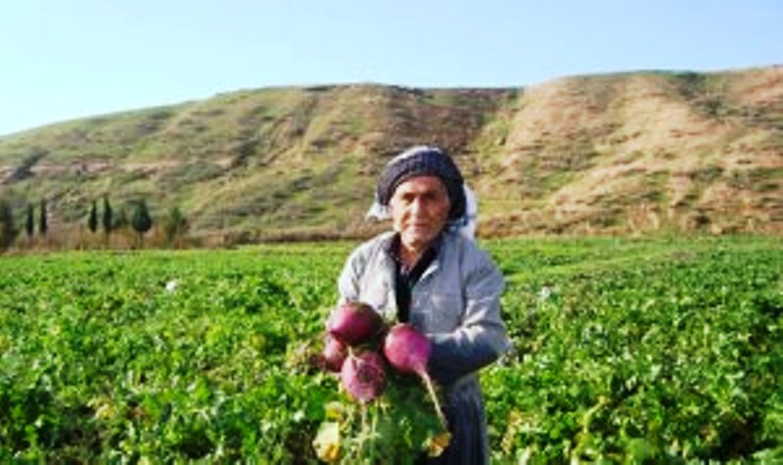
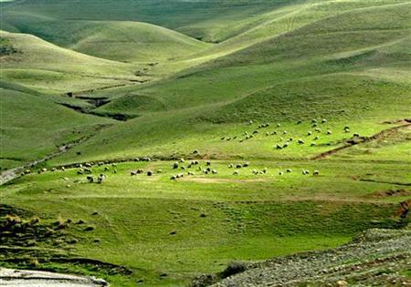
Agriculture in “Kurdistan”

Slide 6
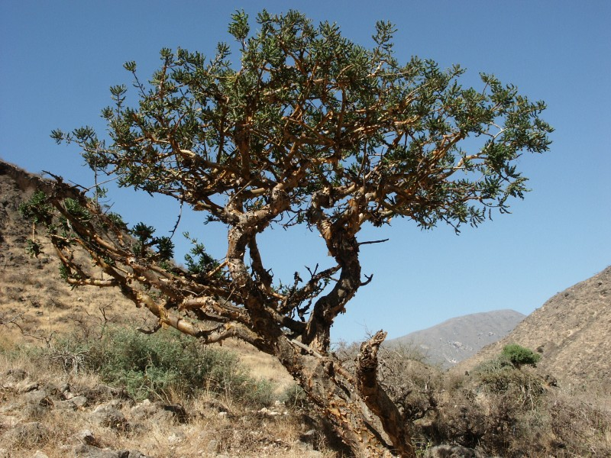
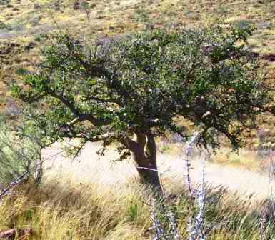
What is this stuff?
Commiphora tree
Boswellia tree

Slide 7
What is this stuff?
Commiphora tree (myrrh)
Boswellia tree
(Frankincense)
Found in present-day Yemen / Oman / Ethiopia

Slide 8
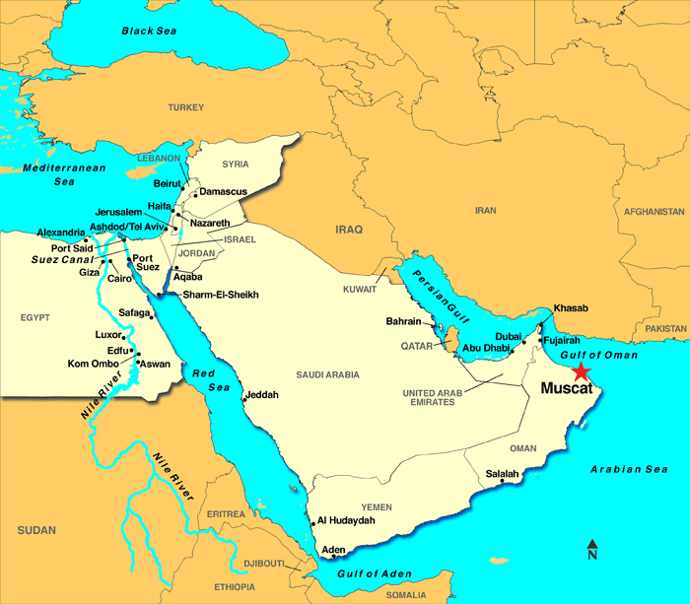

Slide 9
What is this stuff?
Commiphora tree (myrrh)
Boswellia tree
(Frankincense)
Found in present-day Yemen / Oman / Ethiopia

Slide 10
What do you do with it?
Myrrh, Frankincense

Slide 11
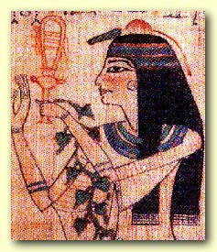
What do you do with it?
Myrrh, Frankincense
Egyptian Eye makeup

Slide 12
What do you do with it?
Myrrh, Frankincense
Egyptian Eye makeup
Funerals, China and India

Slide 13
What do you do with it?
Myrrh, Frankincense
Egyptian Eye makeup
Funerals, China and India
Insect repellant

Slide 14
What do you do with it?
Myrrh, Frankincense
Egyptian Eye makeup
Funerals, China and India
Insect repellant
deodorant

Slide 15
What do you do with it?
Myrrh, Frankincense
Egyptian Eye makeup
Funerals, China and India
Insect repellant
deodorant
Tabernacles Judaism

Slide 16
What do you do with it?
Myrrh, Frankincense
Egyptian Eye makeup
Funerals, China and India
Insect repellant
deodorant
Tabernacles Judaism
Medicine

Slide 17
What do you do with it?
Myrrh, Frankincense
Egyptian Eye makeup
Funerals, China and India
Insect repellant
deodorant
Tabernacles Judaism
Medicine
Cramps, colds, coughs, post-baby, nausea

Slide 18
What do you do with it?
Myrrh, Frankincense
Egyptian Eye makeup
Funerals, China and India
Insect repellant
deodorant
Tabernacles Judaism
Medicine
Cramps, colds, coughs, post-baby, nausea
Roman ritual

Slide 20
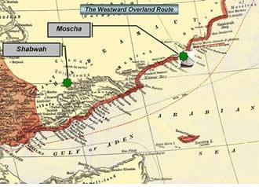
Getting there
Start at Moscha
Sorted at Shabwah

Slide 21
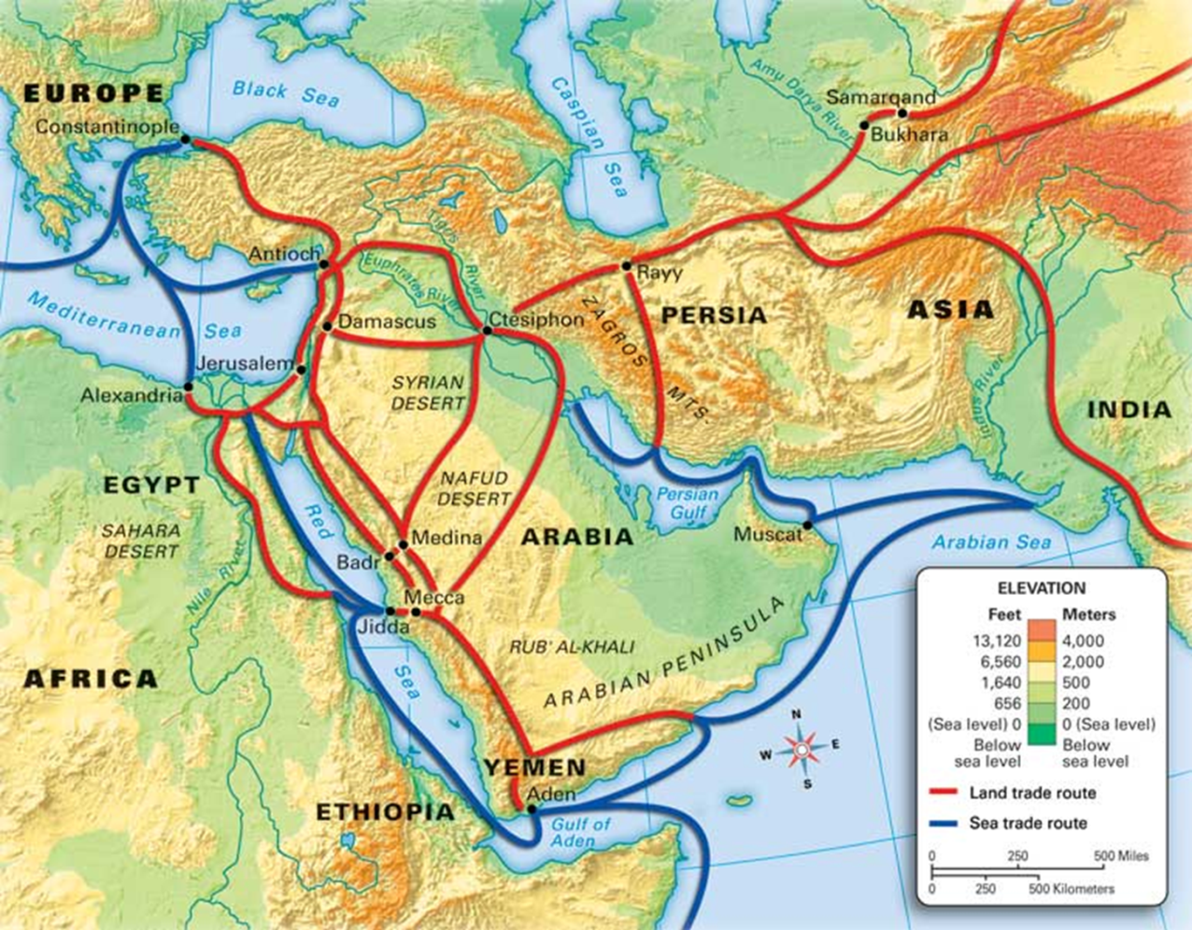
Getting there
Start at Moscha
Sorted at Shabwah
To Medina
Biggest trading hub
lots of mixing

Slide 22
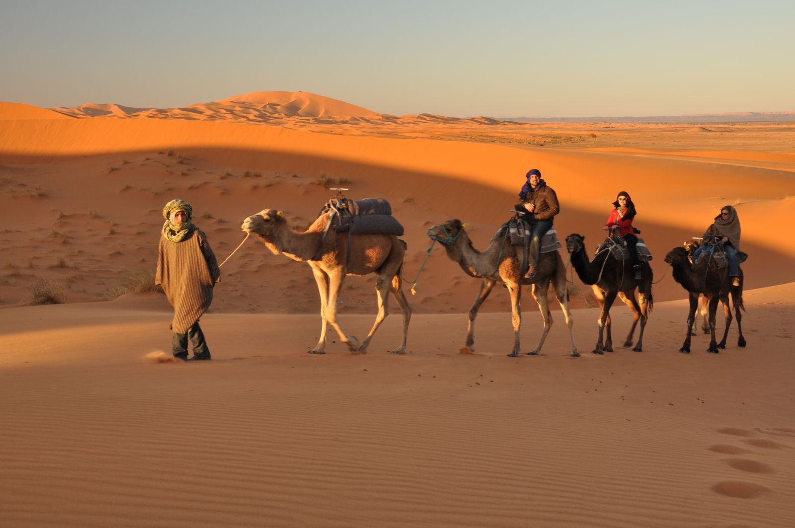
Getting there
Caravans
1000s of camels
2,000 miles of desert
get it to Mediterranean and east
Pays for self

Slide 23
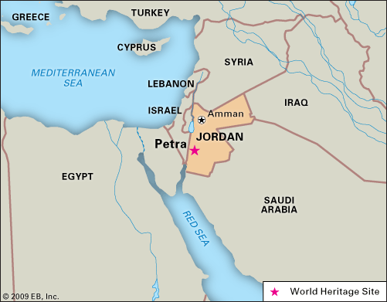
Petra

Slide 24
Petra
Romans vs. Persians, 100 C.E.→
rough on trade
Come through Jordan
Nabataeans provide trade stops.
https://www.youtube.com/watch?v=-7sQQg7MFNw
https://www.youtube.com/watch?v=HCoyRrylVrg

Slide 25
Trade Routes
Ship to
India
Thailand
China
Cultural bridge b/t Arabia and “the east”
Spices
Education
Religion
African gold

Slide 26
Trade Routes
Ship to
Rome
Greece
Egypt
Cultural bridge b/t Arabia and
“the Mediterranean”
Spice
Education
Religion
African Gold

Slide 27
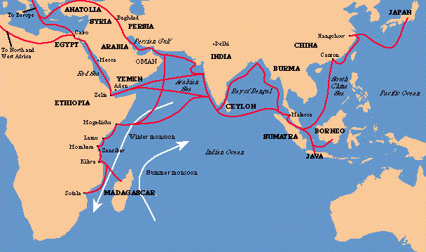
Indian Ocean Trade
Pre “Atlantic”
Gave rise to many
Urban centers along
East-Africa coast of
Swahili culture (inherited from Bantu)
More gold coming out of Africa
More luxury goods coming in (ceramics, glassware, wine, gold, olive oil, perfumes, grain, ivory, precious stones, cotton, spices timber, tin, sandlewood, cloves nutmeg, silks, porcelain, tea)

Slide 28
Big point
Arabia--meeting point for cultures, empires, and wealth.
Lots going on in the region Pre-Islam
Major civilizations connected through trade
Rome and Christianity happened in a specific cultural context . . .
http://www.smithsonianmag.com/smithsonian-institution/roads-of-arabia-presents-hundreds-of-recent-finds-that-recast-the-regions-history-127324646/?no-ist

