Slide 2
Aksumites, Nubia, and Bantu, oh my!: early Civilizations on the African Continent

Slide 3
Last Time . . .

Slide 4
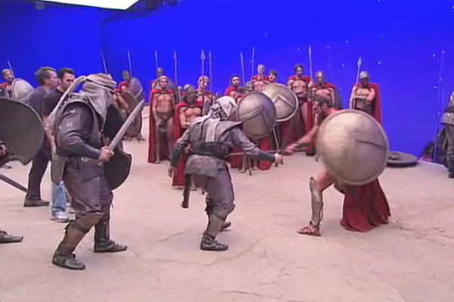
300—The FILM
Takeaways from the assignment
Hollywood is very sexy
Can use music / light / costume / script / CHANGING FACTS to spin stories
Stories are fun!
Don’t let them tell you what to think

Slide 5
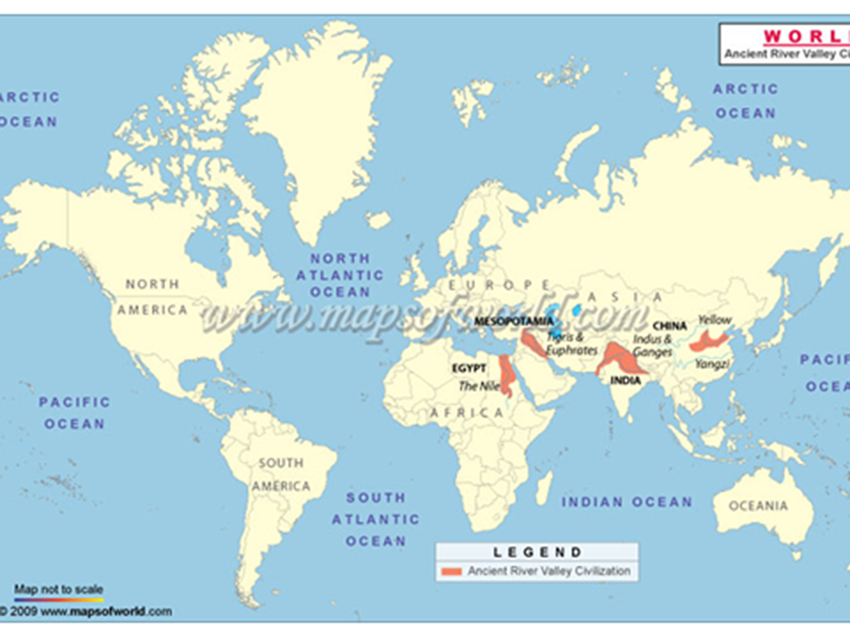

Slide 6
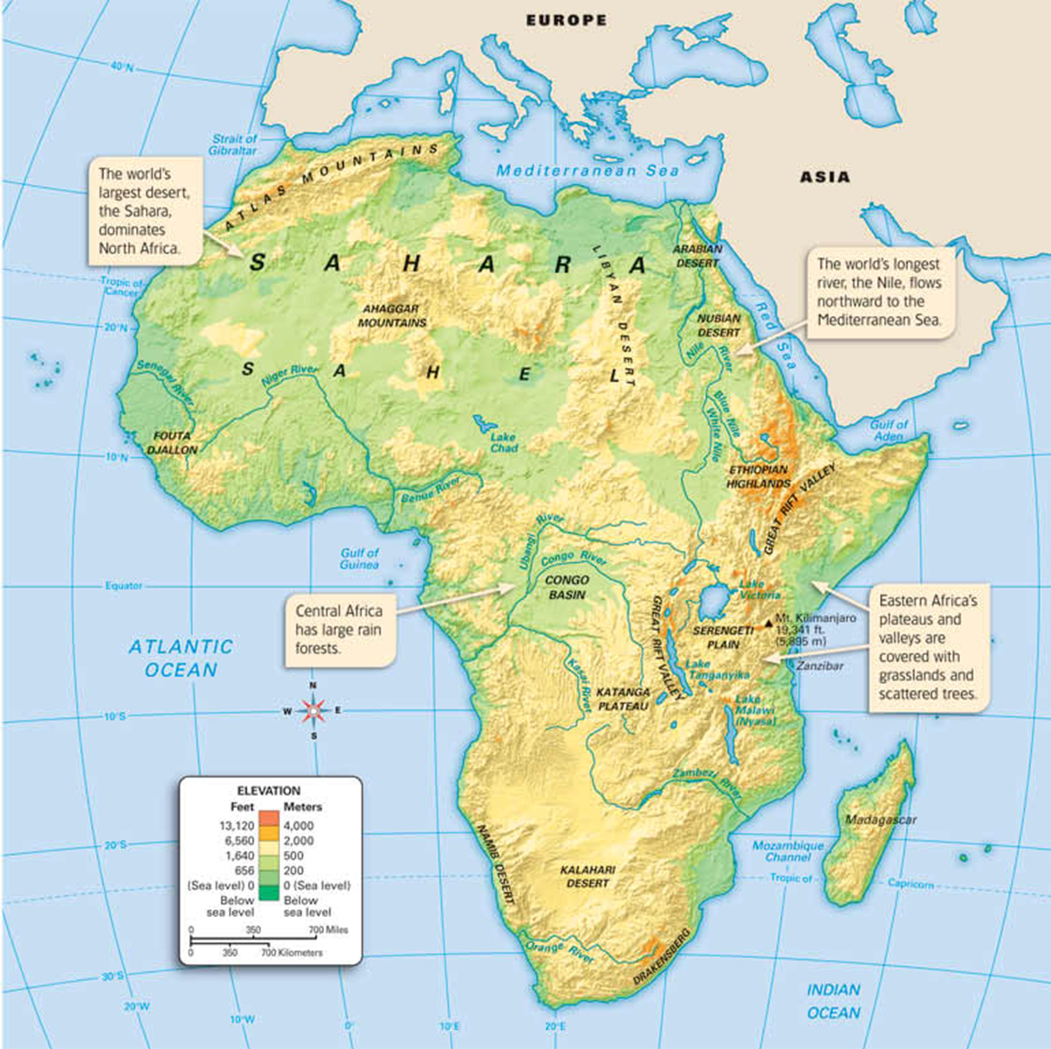
We (I) have neglected African Societies
Lots of civilizations
“stateless societies”
Little writing (that we know of)
Environment not good for artifacts
Outside accounts: “othering”
1/5 of the World’s Landmass

Slide 7
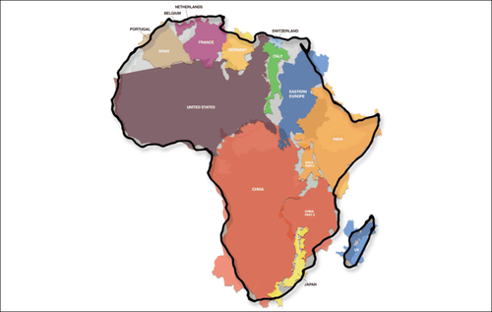

Slide 8
We (I) have neglected African Societies
Lots of civilizations
“stateless societies”
Little writing (that we know of)
Environment not good for artifacts
Outside accounts: “othering”
1/5 of the World’s Landmass
MENTAL

Slide 9
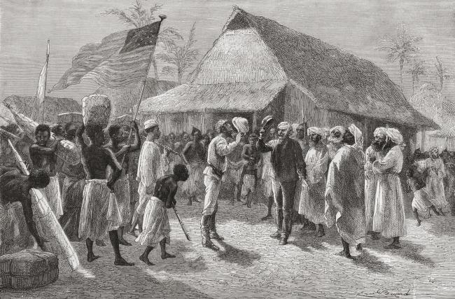
“Dr. Livingston, I presume?”
Where this mindset comes from: European / American Imperialism in the 1800s
https://www.youtube.com/watch?v=ngggl6Afc3E

Slide 10
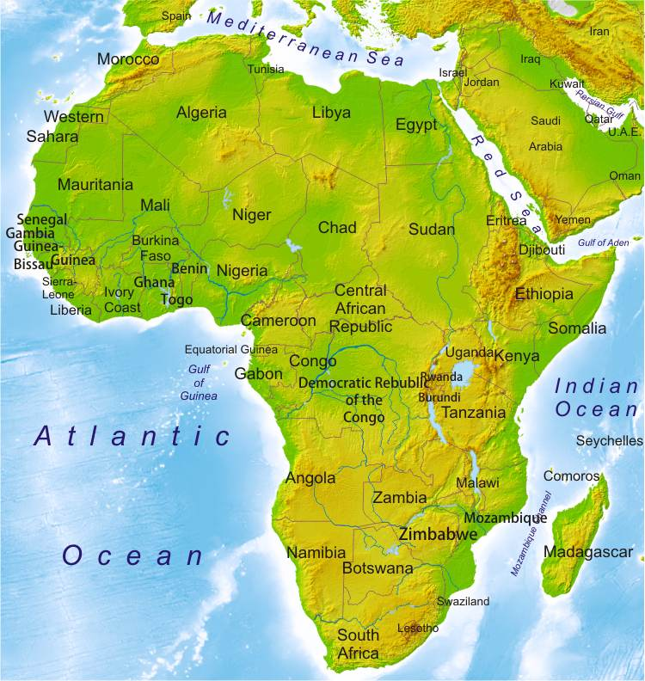

Slide 11
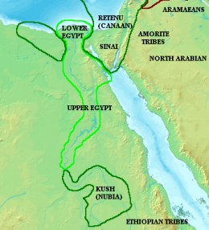
Nilo-Saharan-speaking peoples of Nubia
centralized around Egyptian trading post
2000-1500 B.C.E.
Kingdom of Kush (1070 B.C.E.-350 C.E.)
Egypt, Greece, Rome

Slide 12
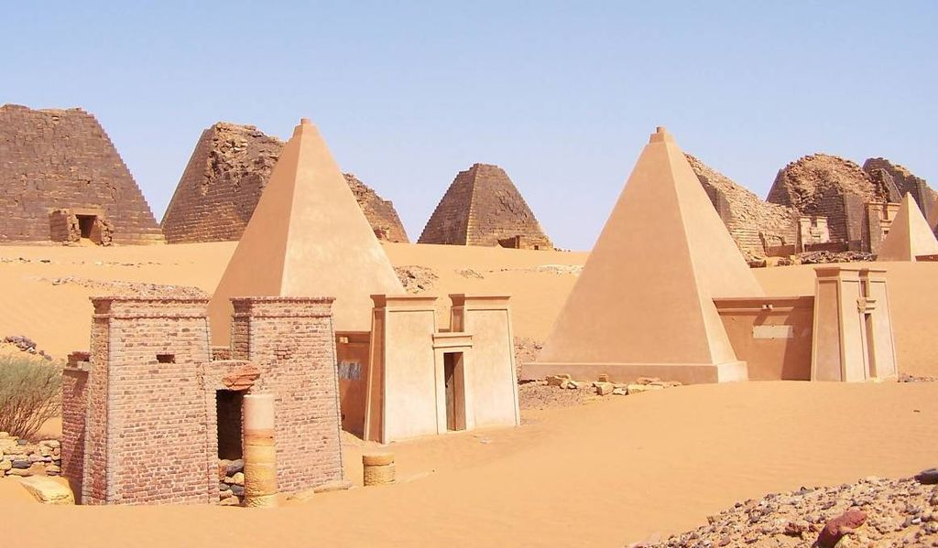
Kushite Pyramids! (UNESCO World Heritage Site)

Slide 13
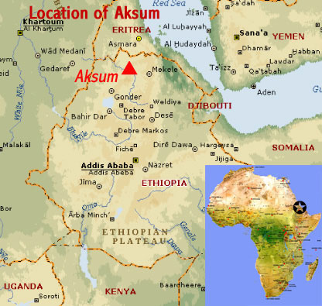
Aksumite
Empire
300-
800 C.E.

Slide 14
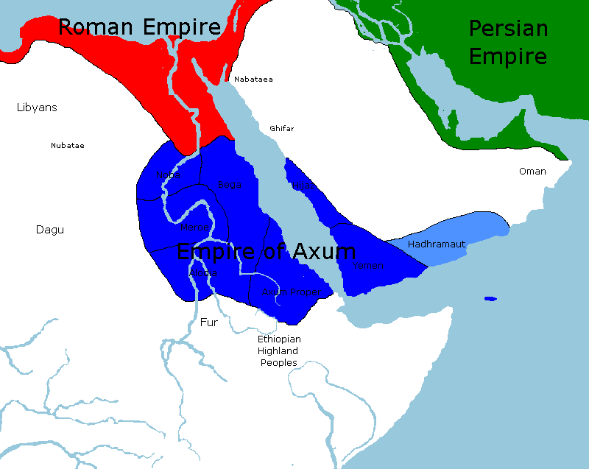

Slide 15
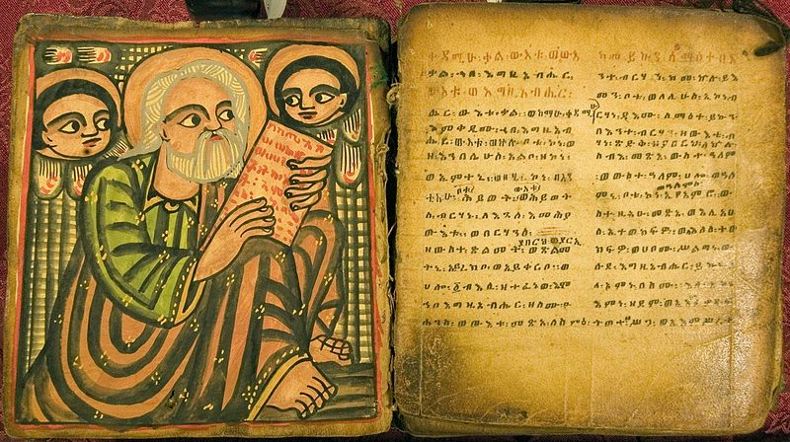
Ge’ez

Slide 16
Ge’ez; Eastern Orthodox

Slide 17
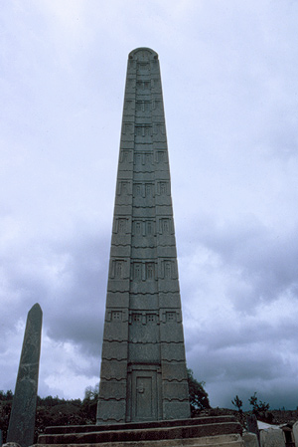
Monolith / Stael
3’-97’
Rock from west
Carved
Near burial sites
(think Pyramids/ Stonehenge)

Slide 18
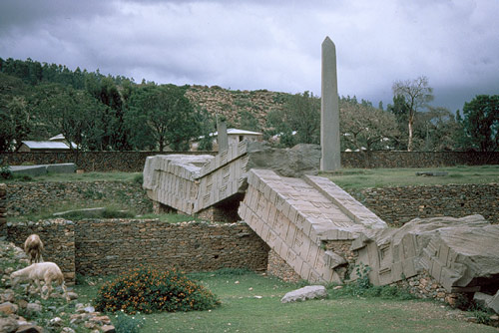

Slide 19
Location, location, location:
Trade
Coffee

Slide 21
Location, location, location:
Trade
Coffee
Coinage
Luxury

Slide 22
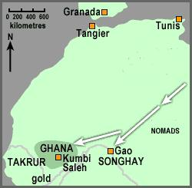
Takrur; Ghana, Gao, from 1000 C.E.
Gold trade

Slide 23
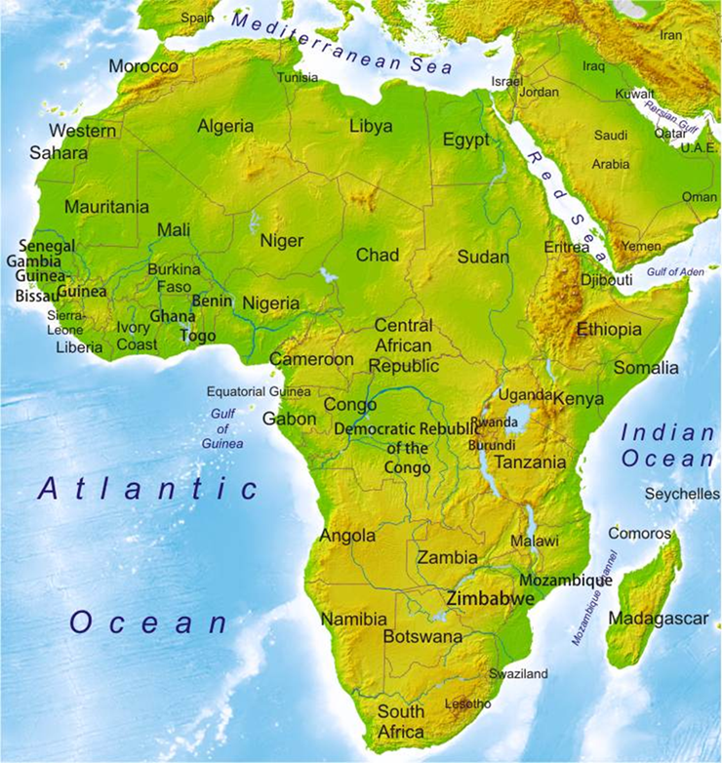
Bantu-speaking peoples
Stateless
600 Bantu languages
Colonize sub-Saharan Africa
Khoisan
Changed face of the landscape and way of life for millions

