Slide 1
Ancient Egypt Beliefs about the Afterlife

Slide 2
Beliefs
Belief in Immortality – life after death
Believed the afterlife was a continuation of their life; death was a transitional state between the two worlds
Transition was difficult
Notes:
https://maa.missouri.edu/gallery/death-and-afterlife-ancient-egypt

Slide 3
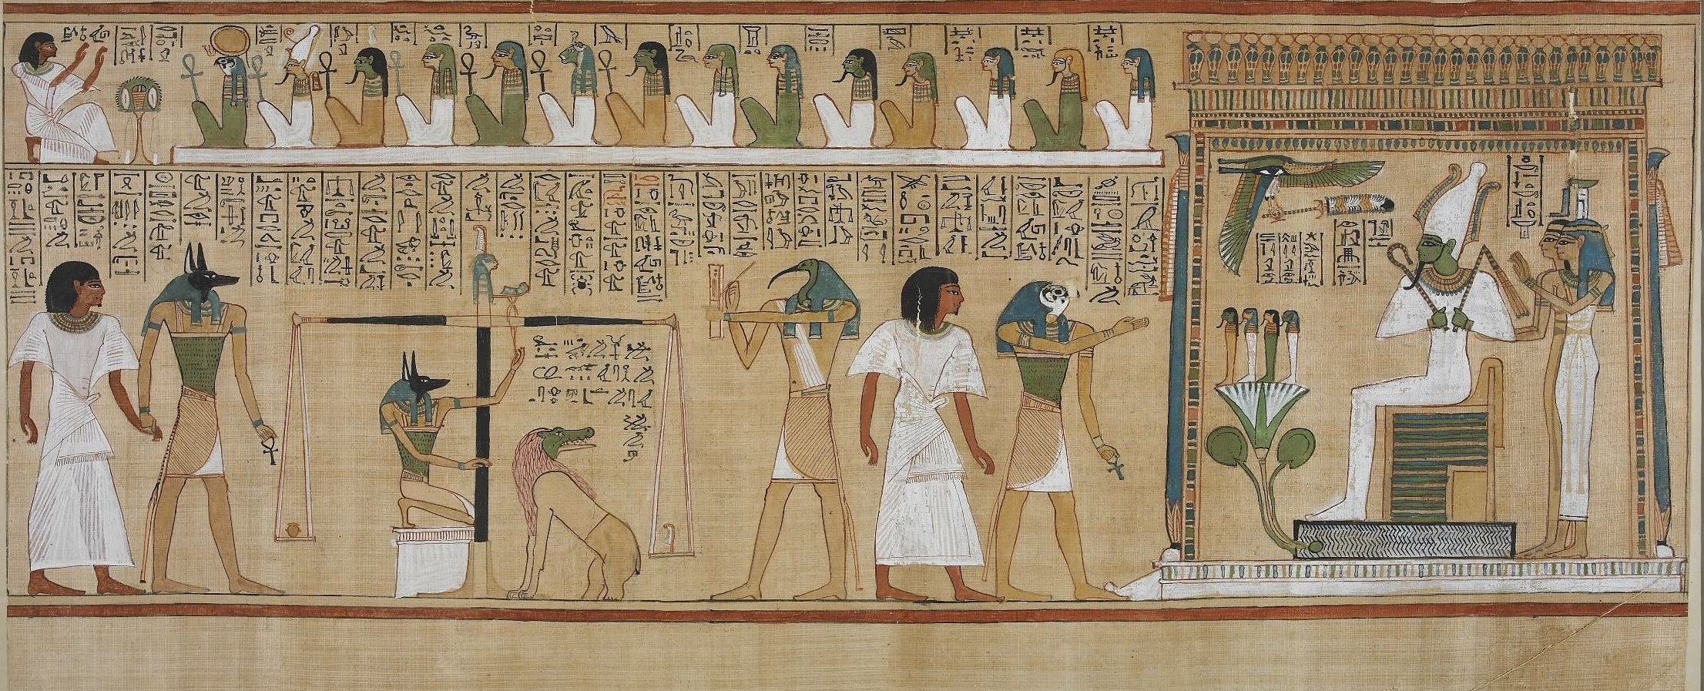
Entering the Afterlife
Had to pass a series of tests – these were outlined in the Book of the Dead - a collection of spells and prayers to help obtain life after death
Final judgment took place before Osiris, the god of the harvest and eternal life.
The deceased’s heart was weighed against the feather of truth.
If the scale balanced, Osiris permitted the deceased to enter the Field of Reeds, a paradisiacal world of plenty.
If the heart was heavy with sin, the crocodile-headed monster Ammit (Eater of the Dead) devoured the deceased and his/her afterlife ended in torment and shame.
Notes:
https://maa.missouri.edu/gallery/death-and-afterlife-ancient-Egypt
NOTE: Bring attention to the image and the scales on the left. It also shows Osiris and Ammit.

Slide 4
Beliefs
Believed that without the body the soul could no longer exist
Egyptians believed that the akh, the ba, and the ka were the three parts of the soul.
The ba and ha remained in the tomb and therefore needed the body
The akh left the body and moved on to eternal life
This impacted the practices around death and burial
Tombs and items included
Mummification
Notes:
https://maa.missouri.edu/gallery/death-and-afterlife-ancient-egypt

Slide 5
Items often included in tombs:
Tombs would include various items that they believed would be needed in the afterlife
Food and drink
Transportation to help their travel to the afterlife
Jewelry
Clothing
Furniture
Tools
How wealthy or important a person was in society influenced how much someone was buried with
Pharaohs obviously had the most elaborate tombs and objects buried with them

Slide 6
Mummification and Embalming
Embalming = the process of preserving a body
Key organs taken out of the body, treated with a special salt to dry them out (natron), and stored in canopic jars
The heart remained in the body- believed the heart was the center of one’s existence
Body was filled with spices and perfumes, stitched closed, and rubbed with oils.
Body was then wrapped (making it a “mummy”)
Used long strips of linen
~70 day process
The mummy was then put in a series of wooden coffins (if a pharaoh or in the higher levels of the society) to be put in the tomb

